Slide 1
Big Mountain Resort
by David VanHeeswijk

Slide 2
Problem Statement
How can we increase revenue or reduce costs?
Increase ticket prices?
Remove runs from the resort?
Add more area with snow making guaranteed?
Increasing longest run or adding to other features?

Slide 3
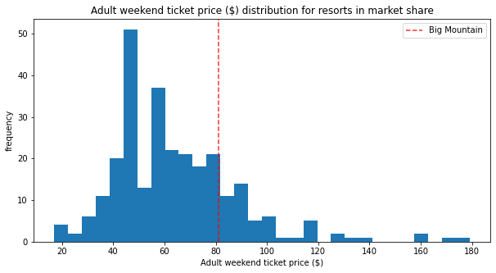
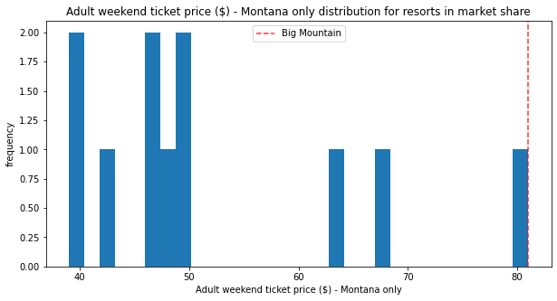
Ticket Price for Big Mountain
Ticket Price vs Overall Market
Ticket Price vs Montana

Slide 4
Recommendations
Model Supported Recommendations:
Current price ($81.00) is below recommended price of $95.87
Even with $10 mean absolute error, a ticket price increase would be supported by the model.
Recommend that the ticket be increased initially, with no other changes, to $85.00 per person at least.
Possible Considerations for Caution:
Assumption is based on other resorts pricing is accurate.
Some resorts in the data set we have might be underpriced or overpriced, skewing the overall prediction slightly.
Investigating other similar resorts should help to confirm our suspicions or our model.

Slide 5
Board Recommended Scenarios
1. Permanently closing down up to 10 of the least used runs. This doesn't impact any other resort statistics.
2. Increase the vertical drop by adding a run to a point 150 feet lower down but requiring the installation of an additional chair lift to bring skiers back up, without additional snow making coverage
3. Same as number 2, but adding 2 acres of snow making cover
4. Increase the longest run by 0.2 mile to boast 3.5 miles length, requiring an additional snow making coverage of 4 acres

Slide 6
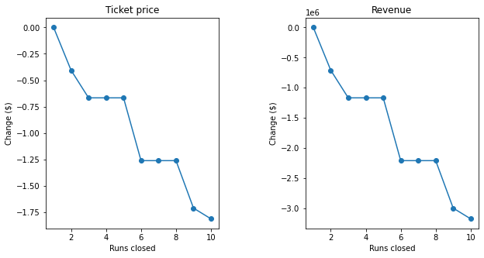
Model Supported Actions
Scenario 2 most likely to create more revenue and higher ticket price support:
Ticket prices could be raised nearly $2 per ticket
Overall revenue would likely increase by nearly $3.5 million!
Scenario 1 also possible source reducing costs
Need more info on overall cost reduction per run removal

Slide 7
To Wrap up...
Prices can be increased on the assumption that resort pricing is accurate across the data set
Increasing the vertical drop will add the most value to both ticket price and overall revenue.
Removing runs may lead to cost cutting initiatives that produce value overall, but need more information to pursue further
Other considerations?
More information on average visitors to each resort may help improve the model
Data on all costs within the resort will increase the accuracy of how much ticket pricing and revenue can be adjusted with various cost reducing or increasing actions.

